Slide 1
GH-200: Automate your workflow with GitHub Actions Part 2 of 2
GH-200: Automate your workflow with GitHub Actions Part 2 of 2
Notes:
https://learn.microsoft.com/en-us/training/paths/github-actions-2/

Slide 2
Module 5: Leverage GitHub Actions to publish to GitHub Packages
GH-200: Leverage GitHub Actions to publish to GitHub Packages
Notes:
Title: Module 5: Leverage GitHub Actions to publish to GitHub Packages
Learning Objectives:
By the end of this unit, you'll be able to:
Understand what a Package Repository is and when to use it.
Set up a Continuous Integration (CI) workflow with GitHub Actions to publish to GitHub Packages.
Validate your knowledge with an exercise that checks your ability to publish to a GitHub Packages registry.
Identify how to authenticate, install, and manage GitHub Packages.
Module Units
Introduction1 min
What is GitHub Packages?3 min
Publish to GitHub Packages and GitHub Container Registry3 min
Knowledge check2 min
Exercise - Publish to a GitHub Packages registry25 min
GitHub Packages for code packages3 min
Module assessment2 min
Summary2 min

Slide 3
Introduction
In this module, you will learn how to automate the publication of code libraries (npm, NuGet, Maven, RubyGems) and containers to public or private GitHub Packages using GitHub Actions and your existing GitHub login for secure access. You’ll see how to streamline packaging and sharing within GitHub with just a few minutes of setup.
By the end of this unit, you'll be able to:
Understand what a Package Repository is and when to use it
Set up a Continuous Integration (CI) workflow with GitHub Actions to publish to GitHub Packages
Validate your knowledge with an exercise that checks your ability to publish to a GitHub Packages registry
Identify how to authenticate, install, and manage GitHub Packages
Notes:
In this module, we’re going to explore how GitHub Packages turns your repository into a full‑featured package registry—whether you’re publishing npm modules, NuGet packages, Maven artifacts, RubyGems, or Docker containers. You already know public registries like npm, but integrating your own private or public packages directly into GitHub lets you unify code, CI/CD, and package management under a single platform. We’ll show you how to automate the entire publication pipeline using GitHub Actions in just a few minutes, so your teams can share and consume libraries seamlessly and securely.”
By the end of this session, you’ll be able to:
Understand Package Repositories: Recognize what a package repository is, why you’d choose one, and the scenarios—such as sharing internal libraries or container images—where GitHub Packages shines.
Set Up CI for Publication: Configure a Continuous Integration workflow with GitHub Actions that automatically builds, tests, and publishes your packages to GitHub Packages whenever code is merged.
Validate with an Exercise: Apply your knowledge in a hands‑on exercise that guides you through publishing to a GitHub Packages registry and confirms you’ve mastered the key steps.
Manage Authentication & Usage: Identify how to authenticate with your registry—using tokens or the built‑in GITHUB_TOKEN—and learn how to install, version, and troubleshoot packages stored in GitHub.

Slide 4
What is GitHub Packages?
GitHub Packages is a package-management service that makes it easy to publish public or private packages next to your source code.
Note: If you are not already familiar with GitHub, check out the Introduction to GitHub Learn module.
GitHub Packages is a package registry
GitHub Packages allow you to share your project dependencies within your organization or publicly.
When you work on a project that has package dependencies, it’s important for you to trust them, understand their code, and connect with the community who built them. Within organizations, you also need to be able to quickly find what’s been approved for your use.
GitHub Packages use the same familiar GitHub interface to find public packages anywhere on GitHub, or private packages within your organization or repositories.
Notes:
GitHub Packages is GitHub’s integrated package management service that lets you publish, host, and consume packages (such as npm, NuGet, Maven, RubyGems, and Docker container images) alongside your source code.
It provides a unified interface to discover public packages or restrict access to private packages within your organization or repository, using the same GitHub authentication and permission models.
With GitHub Packages, you can automate publishing and versioning via GitHub Actions workflows, securely store credentials as secrets, and manage fine-grained access controls so teams can share approved dependencies internally or publish open-source libraries without switching platforms.

Slide 5
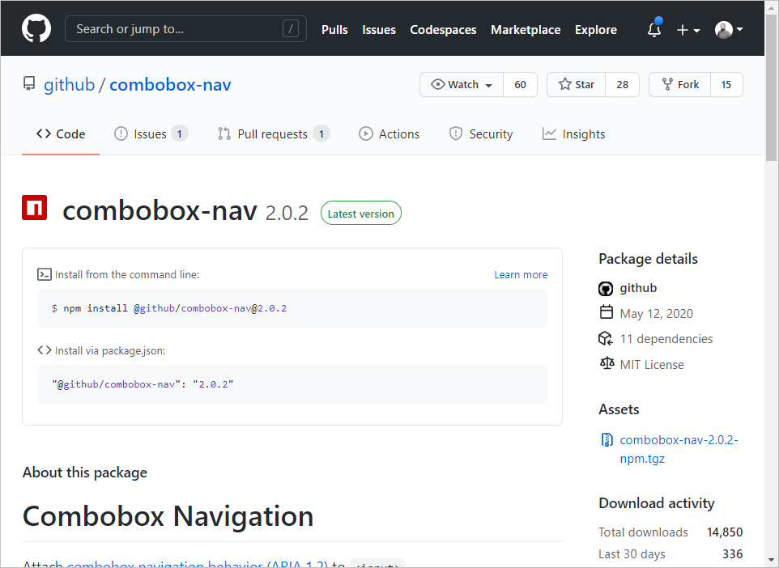
A standard package manager
GitHub Packages is compatible with common package-management clients, so you can publish packages with your choice of tools. If your repository is more complex, you may need to publish multiple packages of different types. You can also use webhooks or GitHub Actions to fully customize your publishing and post-publishing workflows.
Are you publishing an open-source package? Many open-source projects store their code on GitHub, so you can publish prerelease versions of your packages for testing within your community, then easily promote specific versions to the public registry of your choice.
Notes:
GitHub Packages works seamlessly with familiar package-management clients (npm, NuGet, Maven, RubyGems, Docker CLI, etc.), so teams can continue using their existing tooling to publish and consume packages.
Repositories can host multiple package types simultaneously; if your project spans several ecosystems, you can store and version each package alongside its source code without juggling separate registries.
You can integrate webhooks or GitHub Actions into your workflows to automate steps after publishing—such as notifying teams, running additional validation, or triggering deployment pipelines—so your package workflow remains fully customizable.
For open-source projects, you can publish prerelease versions to a scoped registry or GitHub Packages to gather community feedback, then promote stable releases to the broader public registry when ready; this keeps development, testing, and distribution workflows unified within GitHub.
Throughout, GitHub’s authentication and permission model ensures that only approved users or teams can publish or consume private packages, while public packages remain discoverable, giving you confidence in dependency provenance and security.
At the time of writing, GitHub Packages is compatible with the following package managers:
npm, a NodeJS package manager
NuGet, the .NET package manager
RubyGems, a Ruby package manager
Maven and Gradle, two package managers for Java

Slide 6
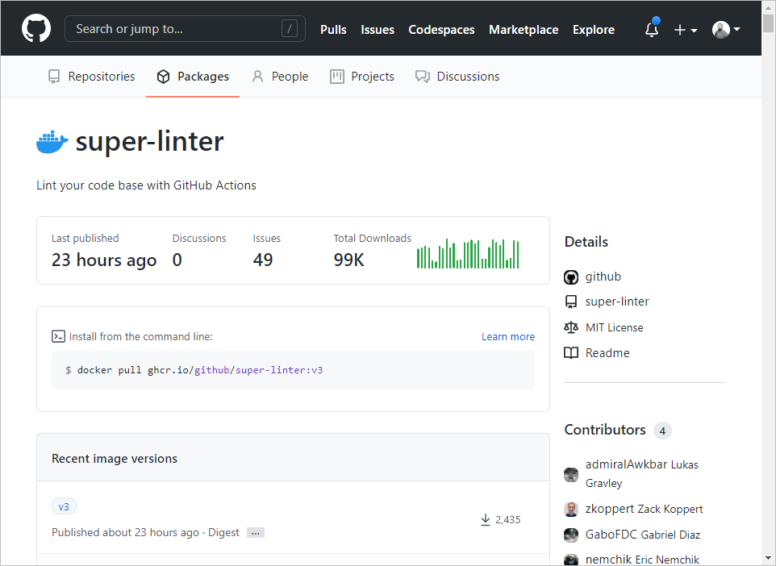
GitHub Packages is also a container registry
From complete applications to CLI utilities, containers are another form of distributing code. GitHub Packages allow you to publish and distribute container images. Once published (in public or in private) you can use these images from anywhere, including:
In your local development environment
As a base image from your GitHub Codespaces development environment
As a step to execute into your Continuous Integration (CI) / Continuous Deployment (CD) workflow with GitHub Actions
On a server or a cloud service
Notes:
GitHub Packages isn’t just for libraries—it also serves as a Docker container registry, letting you publish images alongside your code.
Once you’ve built and pushed an image, you (and your team) can pull it in your local environment just like any other registry: use it for testing or as a base image.
In GitHub Codespaces, you can reference these container images directly, ensuring development environments stay consistent with what runs in CI/CD or production.
Within GitHub Actions workflows, you can pull your container image as a step—whether for building, testing, or deploying—keeping everything unified under the same platform.
Finally, you can deploy these images to your servers or cloud services, public or private, while leveraging GitHub’s authentication and permission controls so only authorized users or systems access them.

Slide 7
Compare GitHub Packages to GitHub Releases
GitHub Packages are used to publish releases of your libraries to a standard package feed or a container registry. They are meant to leverage the ways the specific package-management client works with that feed, like linking back to the repository in which the package was created as well as the version of the code that was used.
GitHub Releases are used to release a bundle of packaged software, along with release notes and links to binary files. You can download those releases directly from their unique URL and track them back to the specific commit they were created from. You can only download releases as tarballs or ZIP files.
Notes:
GitHub Packages lets you publish library releases to a package registry or container registry, using the native package-management client workflows.
Packages link back to the repository and the specific version of code used, fitting into dependency workflows.
GitHub Releases bundles software artifacts (tarballs or ZIPs) with release notes and links to binaries tied to a commit.
Releases are downloaded via their unique URL and track to the originating commit but are not consumed via package managers.

Slide 8
Unified identity and permissions
Let's say you're working on a project using GitHub for hosting source code: JavaScript for the front end, with npm and Java for the back end. You now maintain at least three different sets of user credentials and permissions: for Git, npm, and Maven repositories.
With GitHub Packages, you can use a single set of credentials across your source-code repository, your private npm registry, and your Maven or Gradle private registry. Packages published through GitHub inherit the visibility and permissions assigned at the repository level. A new team member needs read access to a package and its code? Give them read access to the repository and it's done!
Notes:
Let's say you're working on a project using GitHub for hosting source code: JavaScript for the front end, with npm and Java for the back end. You now maintain at least three different sets of user credentials and permissions: for Git, npm, and Maven repositories.
With GitHub Packages, you can use a single set of credentials across your source-code repository, your private npm registry, and your Maven or Gradle private registry. Packages published through GitHub inherit the visibility and permissions assigned at the repository level. A new team member needs read access to a package and its code? Give them read access to the repository and it's done!

Slide 9
Build and publish packages from GitHub
GitHub Actions is another GitHub feature that allows you to automate your software workflows. You can build, test, and deploy your code right from GitHub.
Tip: If you want to learn more about GitHub Actions, check out the Build continuous integration (CI) workflows by using GitHub Actions Learn module.
By combining GitHub Actions and GitHub Packages, you can build a workflow that will build and test your code, and then publish it to GitHub Packages by simply pushing code to your repository.
In the next unit, we'll learn how to use our workflow to publish to GitHub Packages and GitHub Container Registry.
Notes:
GitHub Actions is another GitHub feature that allows you to automate your software workflows. You can build, test, and deploy your code right from GitHub.
Tip: If you want to learn more about GitHub Actions, check out the Build continuous integration (CI) workflows by using GitHub Actions Learn module.
By combining GitHub Actions and GitHub Packages, you can build a workflow that will build and test your code, and then publish it to GitHub Packages by simply pushing code to your repository.
In the next unit, we'll learn how to use our workflow to publish to GitHub Packages and GitHub Container Registry.

Slide 10
Publish to GitHub Packages and GitHub Container Registry
Here, you'll learn the basics of using a workflow to publish to GitHub Packages, and the necessary steps to build, authenticate, tag, and push a Docker image to the GitHub Container Registry.
Notes:
In this unit, we’ll dive into how to publish both code libraries and container images directly to GitHub’s own package registries. You’ll see how to build your artifact—whether it’s an npm module, NuGet package, or Docker image—authenticate automatically, tag it correctly, and push it to GitHub Packages or the GitHub Container Registry. By the end, you’ll have a streamlined, repeatable workflow that turns every merged change into a published package or image.

Slide 11
Use a workflow to publish to GitHub Packages
GitHub Packages let you securely publish and consume packages, store your packages alongside your code, and share your packages privately with your team or publicly with the open-source community. You can also use GitHub Actions to automate your packages.
The following slide is an example of a basic workflow that runs whenever a new release is created in a repository. If the tests pass, then the package is published to GitHub Packages.
Notes:
GitHub Packages let you securely publish and consume packages, store your packages alongside your code, and share your packages privately with your team or publicly with the open-source community. You can also use GitHub Actions to automate your packages.
The following slide is an example of a basic workflow that runs whenever a new release is created in a repository. If the tests pass, then the package is published to GitHub Packages

Slide 12
Use a workflow to publish to GitHub Packages (continued)
name: Node.js Package
on:
release:
types: [created]
jobs:
build:
runs-on: ubuntu-latest
steps:
- uses: actions/checkout@v4
- uses: actions/setup-node@v4
with:
node-version: 12
- run: npm ci
- run: npm test
publish-gpr:
needs: build
runs-on: ubuntu-latest
steps:
- uses: actions/checkout@v4
- uses: actions/setup-node@v4
with:
node-version: 12
registry-url: https://npm.pkg.github.com/
- run: npm ci
- run: npm publish
env:
NODE_AUTH_TOKEN: ${{secrets.GITHUB_TOKEN}}
First, the workflow file must exist in the .github/workflows directory. It's common practice to name a workflow that publishes a new package whenever a new release is created something like release-package.yml, to make it easy for project collaborators to understand its purpose without navigating to the workflow file.
The preceding workflow does a few things after a new release is created:
A job named build runs npm ci ("ci" for Continuous Integration) to install dependencies directly from the package-lock.json file, as well as the tests for the project.
Once the build job succeeds, the job named publish-gpr publishes the package.
The workflow publishes the package to the registry-url: https://npm.pkg.github.com/ using an access token for authentication.
Notes:
Let’s walk through this two‑job workflow, which lives in your repository’s .github/workflows directory—typically named something like release-package.yml so it’s self‑descriptive.
Trigger (on: release)
The workflow fires only when a new GitHub release is created, ensuring packages are published in sync with your versioned tags.
Build Job
Environment: Runs on ubuntu-latest.
Steps:
Checkout code (actions/checkout@v4).
Setup Node.js (actions/setup-node@v4 with node-version: 12).
Install dependencies using npm ci, which installs exactly from your package-lock.json.
Run tests via npm test.
Purpose: Validates that your code and tests pass before any publication occurs.
publish-gpr Job
Dependency: Declares needs: build, so it only runs if the build job succeeds.
Environment: Also on ubuntu-latest.
Steps:
Re‑checkout code and setup Node.js—this time pointing registry-url at https://npm.pkg.github.com/.
Install with npm ci again to ensure a clean, matching state.
Publish using npm publish, with authentication provided by the built‑in GITHUB_TOKEN as NODE_AUTH_TOKEN.
Authentication & Registry
By specifying the registry-url and passing ${{ secrets.GITHUB_TOKEN }} to NODE_AUTH_TOKEN, the job securely publishes your package to your GitHub Packages registry without any additional credentials.
This pattern cleanly separates build verification from publication, ensures only validated code is published, and leverages the automatic GITHUB_TOKEN for secure, friction‑free authentication to GitHub Packages.

Slide 13
Use GitHub Container Registry to host and manage Docker container images
GitHub Packages support the use of containers, Kubernetes, and other cloud-native technologies to manage their entire application lifecycle including production operations, development, release, and deployment. GitHub Packages also offers a container registry designed to support the unique needs of container images. You can use GitHub Container Registry to seamlessly host and manage Docker container images in your GitHub organization or personal user account. GitHub Container Registry allows you to configure who can manage and access packages using fine-grained permissions.
With the container registry, you can:
Store container images within your organization and user account rather than a repository.
Set fine-grained permissions for the container images.
Access public container images anonymously.
Notes:
In addition to language‑specific package formats, GitHub Packages provides a dedicated Container Registry for Docker images—enabling end‑to‑end container lifecycle management right alongside your code.
Key advantages include:
Organizational Storage: Rather than coupling images to a single repo, you host them under your GitHub organization or user account namespace—making them easier to discover and manage at scale.
Fine‑Grained Permissions: You can assign read, write, and admin privileges on a per‑image or per‑repository basis, ensuring that only the right teams or services can pull or push specific images.
Public Access: If you choose, container images can be published publicly and pulled anonymously—ideal for distributing base images, shared tooling, or open‑source projects without requiring authentication.
With GitHub Container Registry, you get a secure, integrated container hosting solution that leverages the same identity, audit, and permission controls as your code—simplifying CI/CD pipelines and governance for containerized workloads.

Slide 14
Use GitHub Container Registry to host and manage Docker container images (continued)
After you've built the image and authenticated and signed in to the GitHub Container Registry service at ghcr.io, you can then tag and push the latest version of the image to the container registry using these commands:
echo $GITHUB_TOKEN | docker login ghcr.io -u USERNAME --password-stdin
docker tag IMAGE_ID ghcr.io/OWNER/IMAGE_NAME:latest
docker push ghcr.io/OWNER/IMAGE_NAME:latest
Note: To authenticate using a GitHub Actions workflow, you can use a GITHUB_TOKEN:
For package registries at PACKAGE-REGISTRY.pkg.github.com.
For the container registry at ghcr.io/OWNER/IMAGE-NAME.
Notes:
Once you’ve built your Docker image locally, you need to authenticate to GitHub Container Registry (ghcr.io), tag your image with the appropriate owner and repository path, and then push it. Here’s what happens step by step:
Authenticate with the Registry
echo $GITHUB_TOKEN | docker login ghcr.io -u USERNAME --password-stdin
This command feeds the GITHUB_TOKEN into docker login, authenticating your Docker client to ghcr.io under your GitHub username without exposing the token on the command line.
Tag the Image
docker tag IMAGE_ID ghcr.io/OWNER/IMAGE_NAME:latest
Replace IMAGE_ID with the ID or name of your local image, OWNER with your GitHub organization or username, and IMAGE_NAME with the name you choose for the image. The :latest tag denotes the most recent build.
Push the Image
docker push ghcr.io/OWNER/IMAGE_NAME:latest
This uploads your tagged image to the GitHub Container Registry under your account and repository.
Note: In a GitHub Actions workflow, you can simplify authentication by using the built‑in ${{ secrets.GITHUB_TOKEN }}. This token works for both package registries (e.g., npm.pkg.github.com) and the container registry (ghcr.io/OWNER/IMAGE_NAME), allowing you to automate pushes in your CI/CD pipeline without additional credentials.

Slide 15
Knowledge Checks
Notes:
Here’s a quick set of questions to confirm your grasp of defining workflows, pushing container images, and authenticating with GitHub Container Registry. Try to answer based on what you’ve just learned before moving on.
Read each question carefully and apply the concepts we’ve just covered to choose the best answers.

Slide 16
Knowledge Check: Leverage GitHub Actions to publish to GitHub Packages
1 of 3
In which file do you define the steps to execute in your GitHub Action?
In a workflow.yml (YAML) file
In the Dockerfile
In the package.json file
© Copyright Microsoft Corporation. All rights reserved.
Notes:
In which file do you define the steps to execute in your GitHub Action?
a. In a workflow.yml (YAML) file Explanation: Workflows live under .github/workflows/ as YAML files that define steps.
b. In the Dockerfile Explanation: A Dockerfile defines container image build instructions, not workflow steps.
c. In the package.json file Explanation: package.json can list scripts for a Node.js project, but Actions steps go in workflow YAML.
Correct answer: a

Slide 17
Knowledge Check: Leverage GitHub Actions to publish to GitHub Packages
2 of 3
Which action do you use to publish the latest version of a Docker image to GitHub Container Registry?
docker push ghcr.io/OWNER/IMAGE_NAME
docker push ghcr.io/OWNER/IMAGE_NAME:latest
docker push latest ghcr.io/OWNER/IMAGE_NAME
© Copyright Microsoft Corporation. All rights reserved.
Notes:
Which action do you use to publish the latest version of a Docker image to GitHub Container Registry?
a. docker push ghcr.io/OWNER/IMAGE_NAME Explanation: Omitting a tag defaults to latest only if the local image is tagged without explicit :latest, but best practice is to include the :latest tag.
b. docker push ghcr.io/OWNER/IMAGE_NAME:latest Explanation: This explicitly pushes the latest tag, matching the intent to publish the latest version.
c. docker push latest ghcr.io/OWNER/IMAGE_NAME Explanation: Syntax is incorrect; docker push expects registry/name:tag.
Correct answer: b

Slide 18
Knowledge Check: Leverage GitHub Actions to publish to GitHub Packages
3 of 3
When pulling an image to your local environment, which credentials are needed?
Your GitHub username and a Personal Access Token
The name of the organization and an API Key
The name of the package and a package key
© Copyright Microsoft Corporation. All rights reserved.
Notes:
When pulling an image to your local environment, which credentials are needed?
a. Your GitHub username and a Personal Access Token Explanation: For private images on GitHub Container Registry, you authenticate using your GitHub username and a PAT.
b. The name of the organization and an API Key Explanation: GitHub Container Registry does not use a separate API key; it uses GitHub credentials.
c. The name of the package and a package key Explanation: There is no separate “package key”; authentication is via GitHub credentials.
Correct answer: a

Slide 19
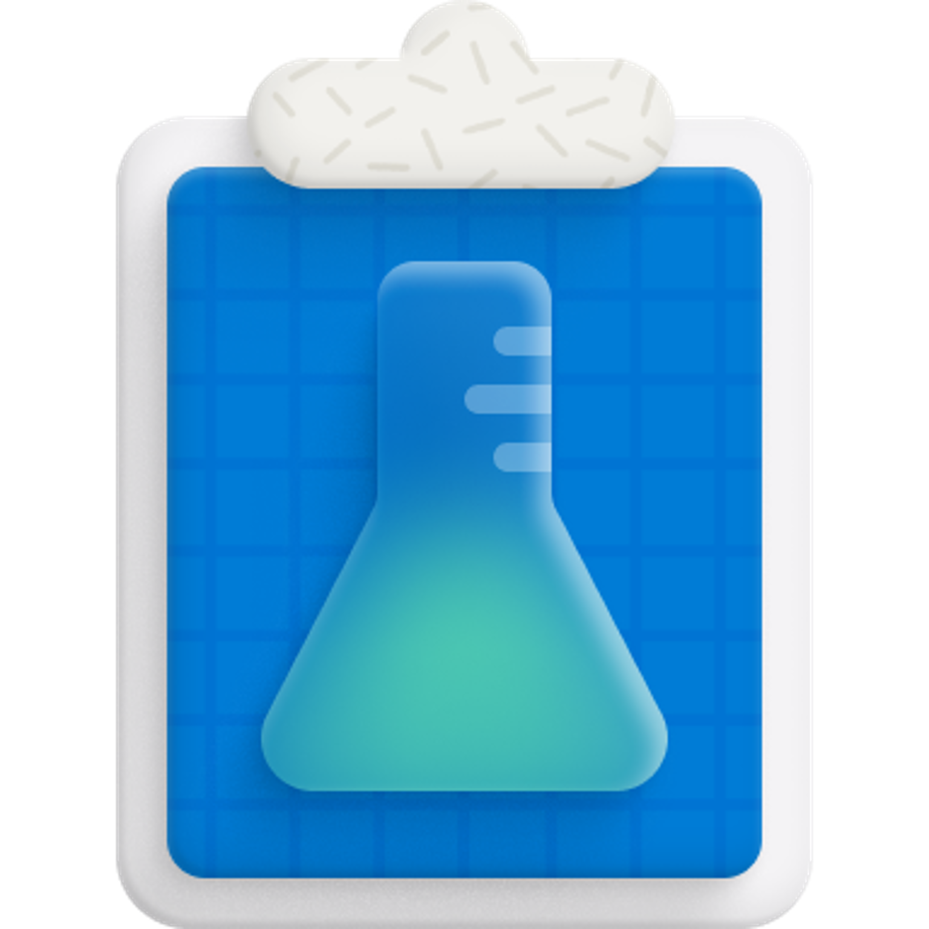
Exercise - Publish to a GitHub Packages registry
In this exercise, you'll navigate to a GitHub repository to validate your ability to publish to a GitHub Packages registry.
This GitHub exercise is graded automatically once you've attempted a solution to the challenge. The results of your actions, as well as helpful feedback, are provided in real-time within the grade-learner workflow logs.
Here are some helpful tips before you begin the exercise:
Read the About this exercise section in the exercise's repository README to understand how the exercise works.
Follow the steps provided in the Instructions section to successfully complete the exercise.
To see the results of your exercise, navigate to the Actions tab of your cloned repository and click the most recent run on the Grading workflow.
Stuck on what to do? Revisit the content in the last unit or check out the Useful resources section in the exercise's repository README for some additional resources.
Notes:
In this hands‑on exercise, you’ll validate your ability to build and publish a package to a GitHub Packages registry by implementing a workflow in a test repository. The exercise is automatically graded—once you push your workflow changes, the grade‑learner workflow will run and give you feedback in real time.
Before you begin:
Read the About this exercise section in the repository’s README to understand the challenge goals.
Follow the steps in the Instructions section of the README to complete the workflow implementation.
Check your results under the Actions tab by selecting the most recent Grading workflow run.

Slide 20
Exercise - (continued)
Note: A grading script exists under .github/workflows/grading.yml. You don't need to modify this workflow to complete this exercise. Altering the contents in this workflow can break the exercise's ability to validate your actions, provide feedback, or grade the results.
This exercise is a challenge based on content covered in this module. It might take several attempts to complete the exercise, you can revisit previous content in this module, or navigate to some of the other resources provided as many times as you want to find the solution.
Start the exercise on GitHub.
Notes:
If you get stuck, revisit our previous unit on sensitive‑data removal or use the “Useful resources” links in the exercise’s README. Remember: do not modify the .github/workflows/grading.yml file, as it’s the script that validates your work.
Click Start the exercise on GitHub when you’re ready!

Slide 21
GitHub Packages for code packages
In the previous unit, you saw how to use GitHub Actions to build and publish container images.
In this unit, we'll take a look at the other packages supported by GitHub Packages. GitHub Packages work with your current project's ecosystem tooling: npm for npm packages, nuget.exe or the dotnet CLI for NuGet packages, etc.
Authenticate to GitHub Packages
The way you authenticate into your package manager will depend on your project's ecosystem. Whichever ecosystem you're working with, you'll need three pieces of information:
Your GitHub username
A Personal Access Token
The GitHub Packages endpoint for your package ecosystem
Notes:
In the last unit, we focused on publishing Docker images to the GitHub Container Registry.
Now we’ll turn our attention to code packages—the language‑specific artifacts like npm modules, NuGet packages, Maven artifacts, or RubyGems that power your applications. GitHub Packages integrates directly with each ecosystem’s tooling, so you can manage dependencies and distribution right alongside your source code.

Slide 22

Generate a Personal Access Token
To install, publish, or delete a package, you need an access token. When using your package manager, you must generate a Personal Access Token (PAT). You can generate a PAT via your profile settings.
Warning: Treat your tokens like passwords and keep them secret.
Notes:
To interact with GitHub Packages—whether you’re installing, publishing, or deleting packages—you need a Personal Access Token (PAT) that your package manager can use in place of a password. Here’s how to create one:
Navigate to Your Profile Settings
In GitHub, click your avatar in the top‑right corner and select Settings.
Open Developer Settings → Personal Access Tokens
In the sidebar, choose Developer settings, then Personal access tokens.
Generate a New Token
Click Generate new token, give it a descriptive name (for example, Packages CI Token), and set an expiration date that matches your security policy.
Select Scopes
Check read:packages and write:packages to allow your token to install and publish packages.
If you plan to delete or fully manage packages, also include delete:packages.
Copy and Store Securely
After generating, copy the token immediately—you won’t see it again.
Store it securely (e.g., in a secrets manager), and never check it into your repositories.
Warning: Treat your PAT like a password. Keep it encrypted and rotate it regularly to maintain the security of your packages and repositories.

Slide 23
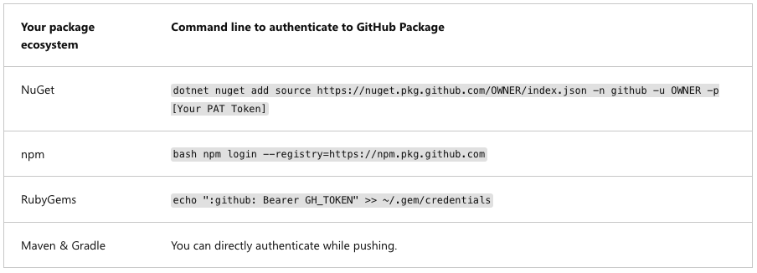
Log in into GitHub Packages
Before publishing or installing packages from GitHub Packages, you'll need to authenticate in your package manager. The endpoint will look like https://PACKAGE_TYPE.pkg.github.com/OWNER/REPOSITORY, where PACKAGE_TYPE is the type of package ecosystem you're using.
The following table shows you the command to run in order to authenticate to GitHub Packages based on your package ecosystem:
If you want to learn more about how to use GitHub Packages with your project's environment, you can read the documentation here.
Notes:
Before you can install or publish packages, you need to configure your package manager to use GitHub Packages as a registry. The registry URL follows the pattern https://<ecosystem>.pkg.github.com/<OWNER> where <ecosystem> could be npm, NuGet, RubyGems, or Maven, and <OWNER> is your GitHub username or organization.
For NuGet, you add a new package source using the GitHub Packages URL and supply your username along with a Personal Access Token.
For npm, you run the npm login command pointed at GitHub’s registry, then enter your credentials when prompted.
For RubyGems, you add an entry in your local credentials file that maps the GitHub host to a “Bearer” token style entry.
For Maven or Gradle, you configure your settings.xml or build file to reference GitHub’s Maven endpoint, supplying your PAT in the server credentials section.
In each case, you use your GitHub username and a PAT with the appropriate read/write scopes so that any install or publish commands will authenticate seamlessly against GitHub Packages. This setup ensures your package manager treats GitHub Packages like any other trusted registry without embedding sensitive values directly in your project files.

Slide 24
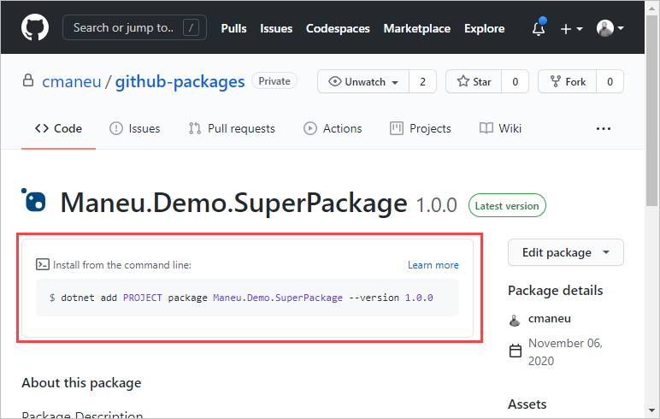
Install a package
When you're authenticated, you can easily use published packages in your projects. Each package home page shows you the command to run, depending on your project environment.
Notes:
Once you’ve authenticated your package manager against GitHub Packages, installing a published package is straightforward. Simply navigate to the package’s page in GitHub—whether it’s an npm module, NuGet package, or Docker image—and you’ll see the exact install command tailored to your ecosystem.
For example, on an npm package’s page you’ll find the npm install syntax preconfigured for your registry; on a NuGet package’s page, the dotnet add package or nuget install command; and for container images you’ll see the docker pull reference.
By relying on the instructions provided on each package home page, you ensure you’re using the correct registry URL, package name, and version specifier—eliminating guesswork and keeping your dependency declarations consistent and secure.

Slide 25
Manage packages
GitHub Packages offer you several ways to easily manage your package lifecycles and workflows.
You can manage GitHub Packages through the GitHub API and the GraphQL API. These APIs allows you to support advanced integrations scenarios. For example, with GitHub's Webhook feature, you can run code when a new package is published. Imagine you're a maintainer of an open-source project. With webhooks, you could automatically publish a new Tweet or a blog post when a new package is published.
You can also use GitHub Actions to automate package management. With the delete-package-versions action, you can automatically prune the oldest version of your packages while publishing a new version.
Notes:
GitHub Packages doesn’t just host your artifacts—it provides a full‑featured API surface and automation hooks to manage them at scale.
APIs for Integration: Both the REST and GraphQL APIs let you query, update, or delete packages and package versions programmatically. You can build custom dashboards, enforce retention policies, or integrate with external systems—all by calling GitHub’s package endpoints.
Webhooks for Event‑Driven Workflows: Subscribe to the package or package_version webhooks so that whenever someone publishes a new version, you can automatically trigger downstream actions—like posting a blog announcement, updating release notes, or notifying social channels.
Actions for Cleanup: Combine GitHub Actions with the delete-package-versions action to automatically prune old package versions whenever you push a new release. This keeps your registry lean, reduces storage costs, and ensures users always install the most recent, secure versions.
By leveraging APIs, webhooks, and Actions together, you can automate every step of your package lifecycle—from publication to retirement—freeing your team from manual maintenance and ensuring your registry stays secure and performant.

Slide 26
Knowledge Checks

Slide 27
Knowledge Check: Leverage GitHub Actions to publish to GitHub Packages
1 of 3
In which scenarios should you NOT use GitHub Packages?
When I want to share code between methods of my application.
When I want to share container images among developers of your team.
When I want to publish a small code library as an open-source project.
© Copyright Microsoft Corporation. All rights reserved.
Notes:
In which scenarios should you NOT use GitHub Packages?
a. When I want to share code between methods of my application. Explanation: Sharing code between methods within the same application is an internal detail and not a scenario for a package registry; you’d include those methods directly in your codebase rather than publishing them as a package.
b. When I want to share container images among developers of your team. Explanation: GitHub Packages (Container Registry) is suitable for sharing container images among your team.
c. When I want to publish a small code library as an open-source project. Explanation: Publishing a small library as open source is exactly a use case for GitHub Packages, so this is not a “do not use” scenario.
Correct answer: a

Slide 28
Knowledge Check: Leverage GitHub Actions to publish to GitHub Packages
2 of 3
When pulling an image to your local environment, which credentials are needed?
Your GitHub username and a Personal Access Token
The name of the organization and an API Key
The name of the package and a package key
© Copyright Microsoft Corporation. All rights reserved.
Notes:
When pulling an image to your local environment, which credentials are needed?
a. Your GitHub username and a Personal Access Token Explanation: For private container images on GitHub Container Registry, you authenticate with your GitHub username and a PAT.
b. The name of the organization and an API Key Explanation: GitHub Container Registry does not use a separate API key; authentication is via GitHub credentials (username + PAT).
c. The name of the package and a package key Explanation: There is no separate “package key” mechanism; you use your GitHub credentials to authenticate.
Correct answer: a

Slide 29
Knowledge Check: Leverage GitHub Actions to publish to GitHub Packages
3 of 3
How can you authenticate to GitHub Packages from your local development environment?
With an API Key
With my GitHub Credentials (username and password)
With a Personal Access Token
© Copyright Microsoft Corporation. All rights reserved.
Notes:
How can you authenticate to GitHub Packages from your local development environment?
a. With an API Key Explanation: GitHub Packages does not use a distinct API key for authentication; it relies on GitHub credentials.
b. With my GitHub Credentials (username and password) Explanation: Direct password authentication is deprecated for many operations; instead, you use a Personal Access Token rather than your raw password.
c. With a Personal Access Token Explanation: You generate a PAT and use it (often with your username) to authenticate to GitHub Packages registries from your local environment.
Correct answer: c

Slide 30
Summary
In this module, you recognized the value of GitHub Packages and when you can use them in your workflow. You used GitHub Actions to build and test your code, and then used a GitHub Actions workflow to publish to GitHub Packages.
Learn more:
Here are some links to more information on the topics we discussed in this module:
Publishing a package
Using GitHub Packages with your project's ecosystem
Pushing and pulling Docker images
Notes:
In this module, you will learn how to integrate GitHub Packages into your development workflow—deciding when to use a package registry, setting up a CI pipeline with GitHub Actions to build and publish packages, and managing authentication and installation of your published artifacts.

